Slide 1
ClassQuest​
Tolani Oke-Steve, Dmytro Stepaniuk , Alvin John Tolentino

Slide 2
Why we want to plan-do this project?​
We want to bring back the spirit of Classcraft, which helped classrooms turn learning into an adventure. Our goal is to design a gamified platform that is engaging, affordable, and flexible. By planning and doing this project, we challenge ourselves as software engineers while addressing a real educational gap: students often see school as a chore, but we can make it fun and motivating.

Slide 3
User and Business Pain Points
Expensive Subscription
No suitable alternative
Poor communication from developers
Complexity of admin access
Need for more customisable characters
Lack of motivation from students in a subject

Slide 4
How we will study-act upon it​?
Study
Analyze what worked and didn’t work in Classcraft, Khan Academy, and ClassDojo.
Gather requirements from our supervising teacher and client to understand their expectations.
Research best practices for gamification, classroom management, and secure data handling.
Act:
Collect feedback from teachers, classmates, and previous users of ClassCraft to refine usability.​
Build a prototype of ClassQuest focusing first on functionality and avatars.
Iterate in short cycles (study, act, and improve) until we have a functional, engaging, and classroom-ready platform.
​

Slide 5
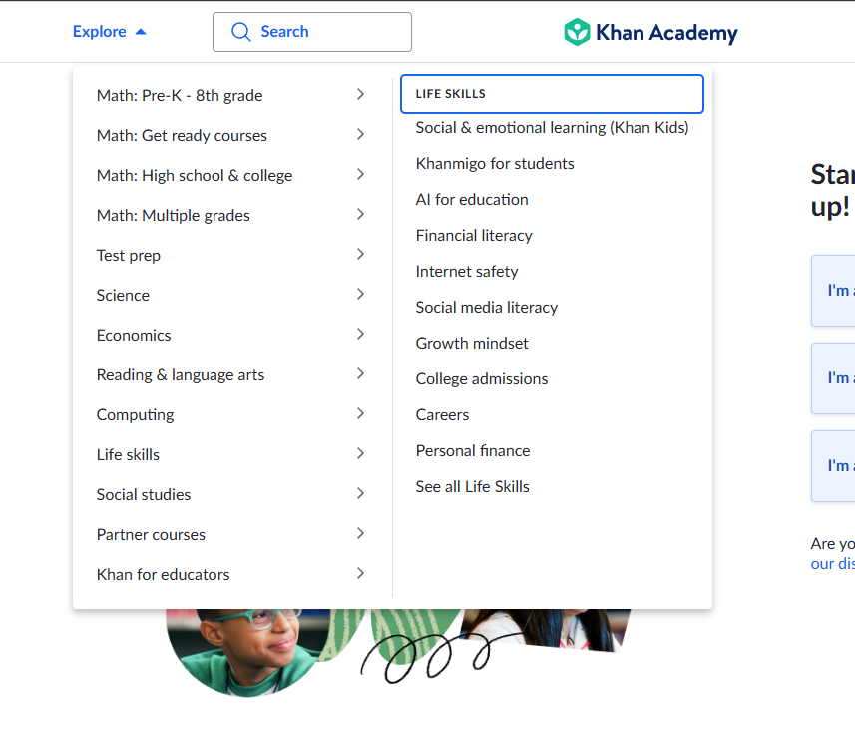
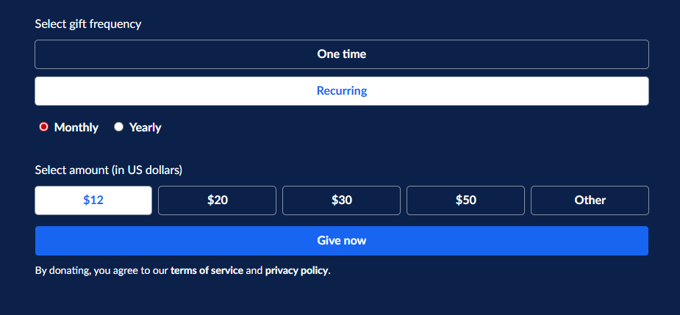
Khan Academy
Strengths
Has a simple interface for parents. Parents can assign assignments for their kids.
Has an AI powered teaching assistant to help boost kid’s learning.
Offers all lessons starting from pre-k to college
Offers Life skills lessons such as social and emotional learning, financial literacy, and internet safety.
Offers partner courses involving NASA, Natural History, and NOVA Labs.
Provides tools for test preparations like SAT, LSAT, and MCAT
Affordability starting at $12/month per student (strength if for an individual)
Weaknesses
Visuals are not as appealing as Classcraft.
The element of “Gaming” is not present making it harder to catch student’s attention.
Expensive as $12/month per student for 30 students would be $360/month.

Slide 6
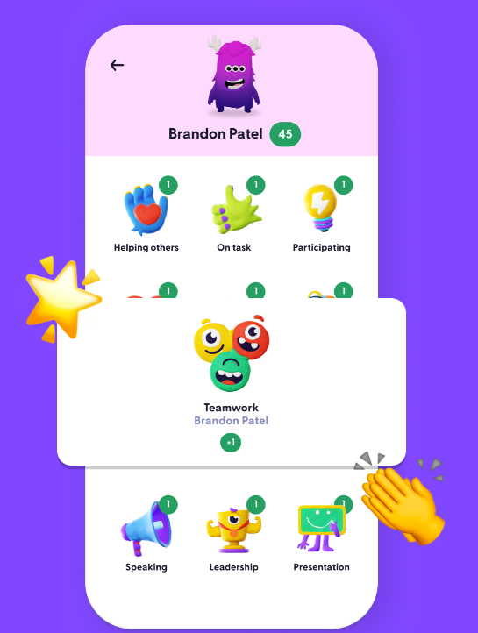
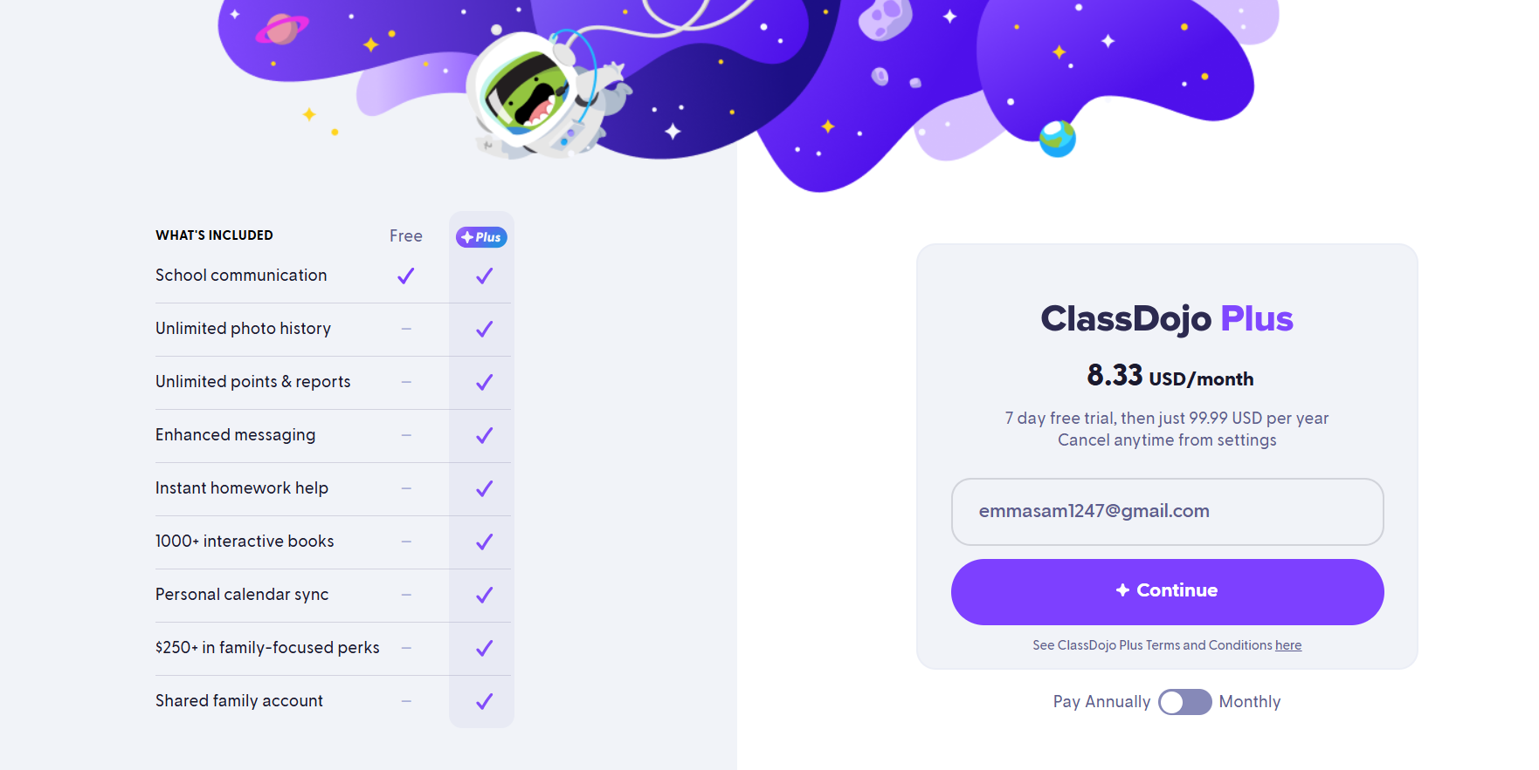
ClassDojo
Strengths
Gives parents a clear window into their child's educational journey. Using the image support feature
Provides language translation making it inclusive for multilingual families
Provides school wide communication/ announcement for admins and teachers to keep everyone informed
Comes equipped with student portfolios, so students can show their achievements
Provides mobile-friendly two way messaging for teachers to reach every family seamlessly
Weaknesses
Limited free features for parents without subscription
There are game mechanics present (no level ups or team challenges)
Costly read receipt feature, without the base subscription users are not informed if their sent messages were read
Lengthy process to award points, teachers find this cumbersome
ClassDojo’s platform only awards rewards, there is no gamification element present (no quests etc.)

Slide 7
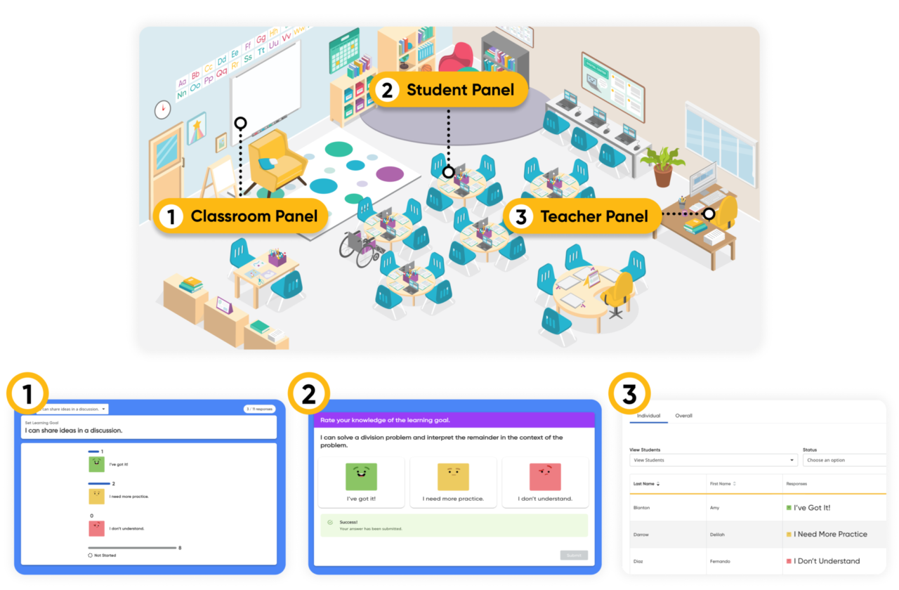
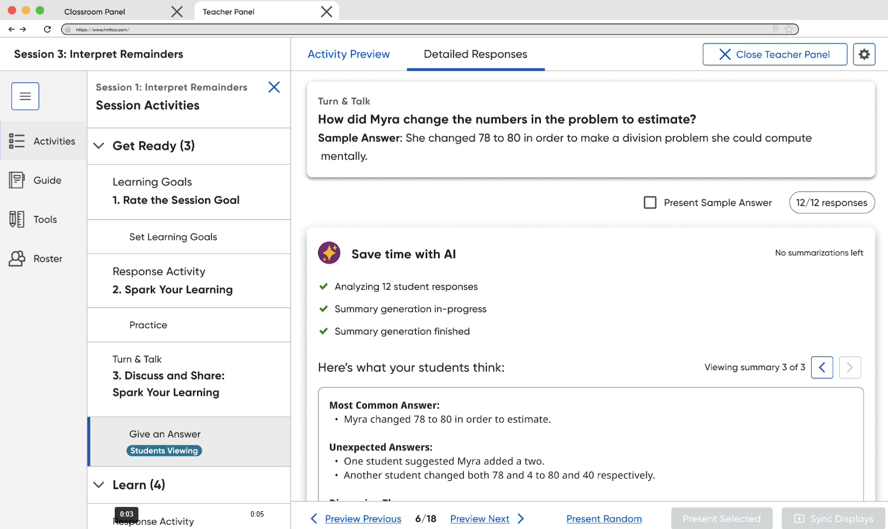
HMH ClassCraft
Strengths
Backed by HMH
Classroom focus with behavior & engagement tools
Game mechanics: points, powers, levels, rewards
Team play builds collaboration & class culture
Integrates with HMH programs/content
Shown to boost student motivation/participation
Weaknesses
Pricing favors school/district; no single-class option
Steep learning curve; heavy setup/maintenance
Feature changes/removals create content uncertainty
Mixed support; non-premium users report slow help
Leans toward behavior/engagement over curriculum alignment

Slide 8
What we will create/iterate and its value?​
We will create a gamified classroom platform where:​
Students build and customize avatars, gain points, unlock rewards, and collaborate in teams.​
Teachers manage classrooms easily and track learning outcomes.​
Parents can log in to see their child’s progress and achievements.​
School administrators can integrate the system across classrooms with security and curriculum adaptation.​
Value:​
Makes learning fun and immersive.​
Provides accountability and transparency for parents.​
Supports teachers with classroom management tools.​
Builds a stronger connection between schools and families.​
​

Slide 9
Who we are creating for​?
Students (elementary) – want fun and engaging learning tools.​
Teachers – need streamlined classroom management.​
Parents – want visibility and ways to support learning at home.​
​

Slide 10
Our Value Proposition
Our platform transforms everyday learning into an adventure where students thrive and collaborate, teachers save time, and parents stay engaged — all at an affordable cost
​

Slide 11
Questions

